Slide 1

SUPERSTORE
SALES ANALYSIS USING PYTHON III

Slide 2
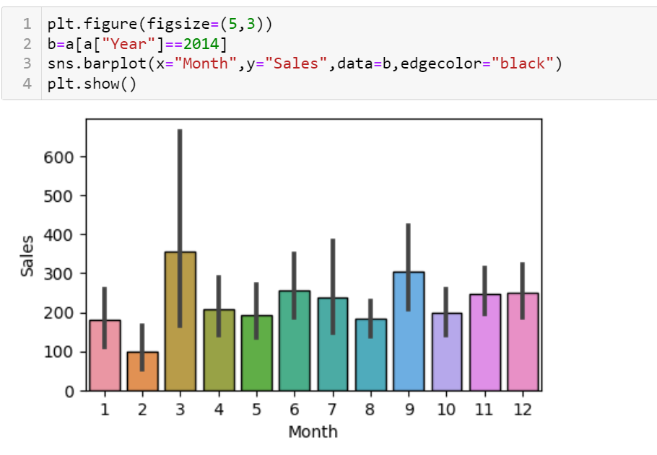
MONTHLY SALES

Slide 3
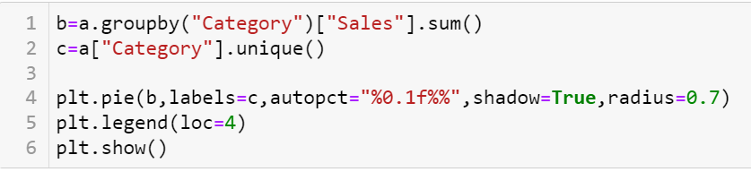
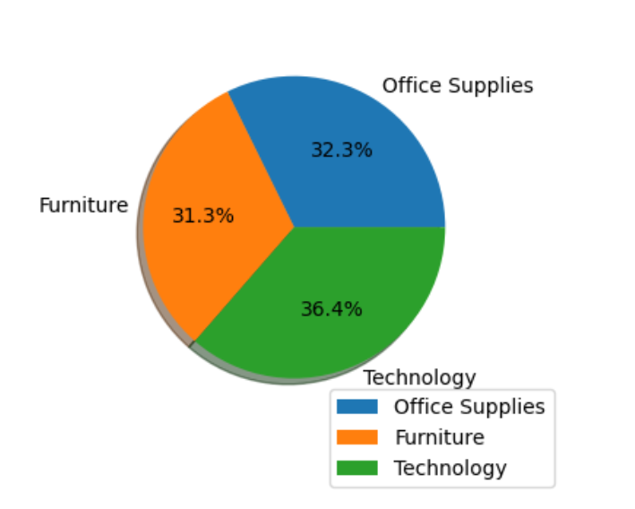
SALES BY CATEGORY

Slide 4
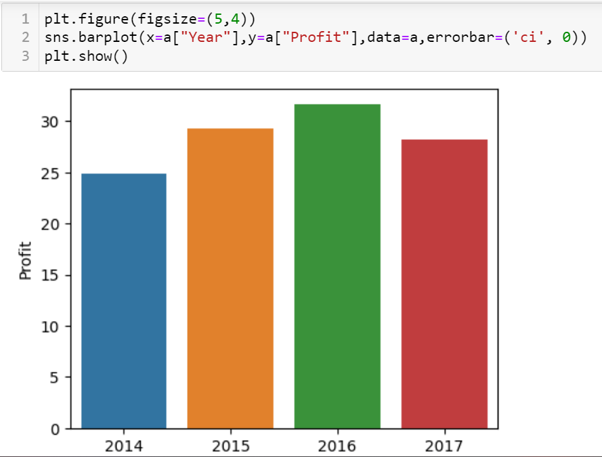
Profit Trend

Slide 5
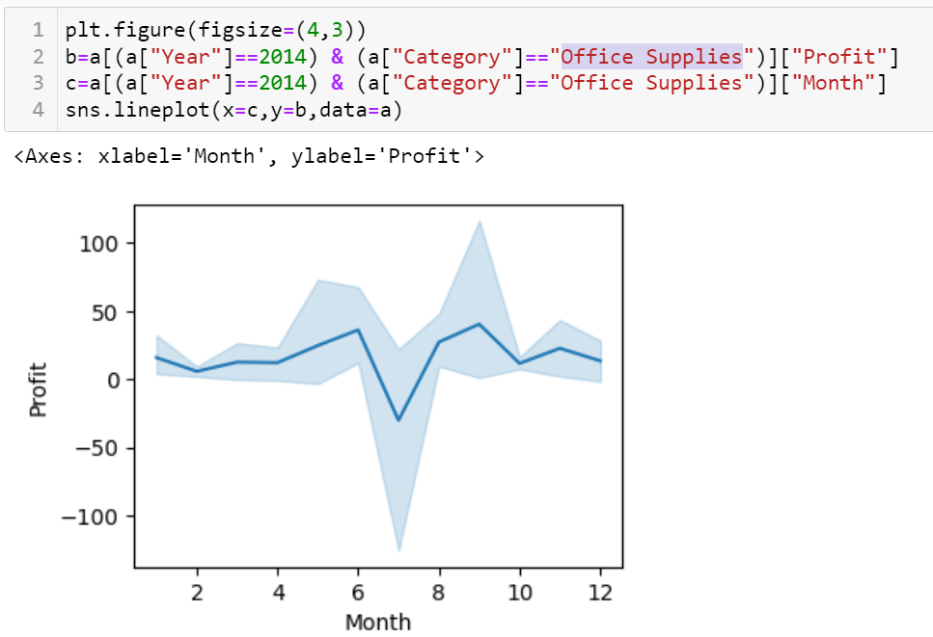
Monthly PROFIT of Office Supplies for year 2014

Slide 6
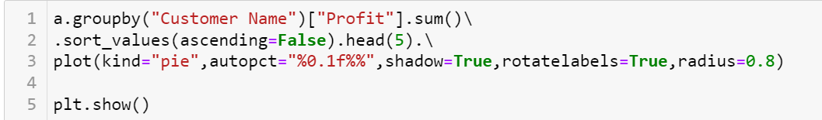
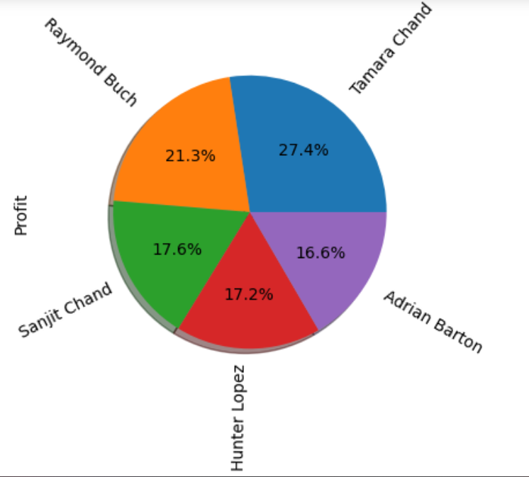
TOP 5 CUSTOMERS

Slide 7
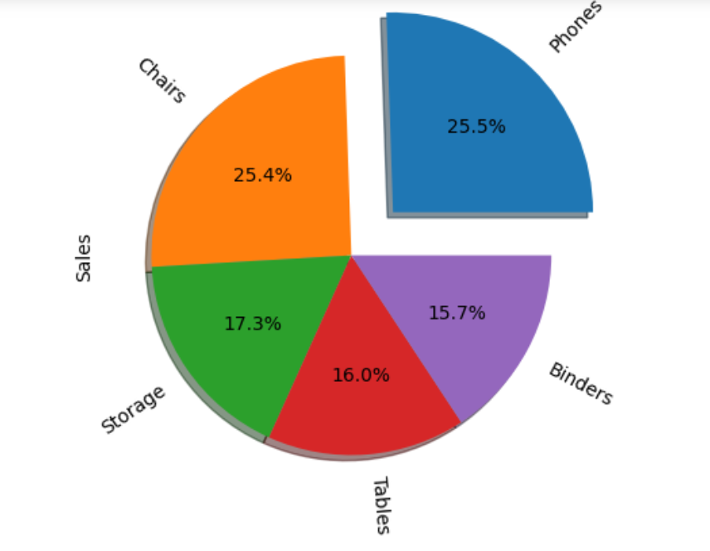
TOP 5 BEST SELLER

Slide 8
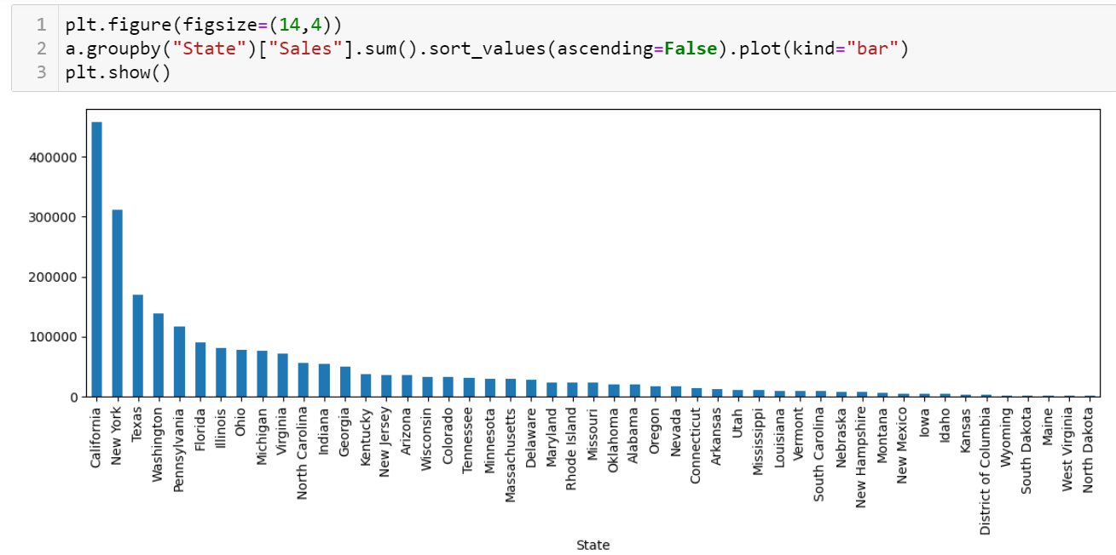
SALES BY STATE

Slide 9
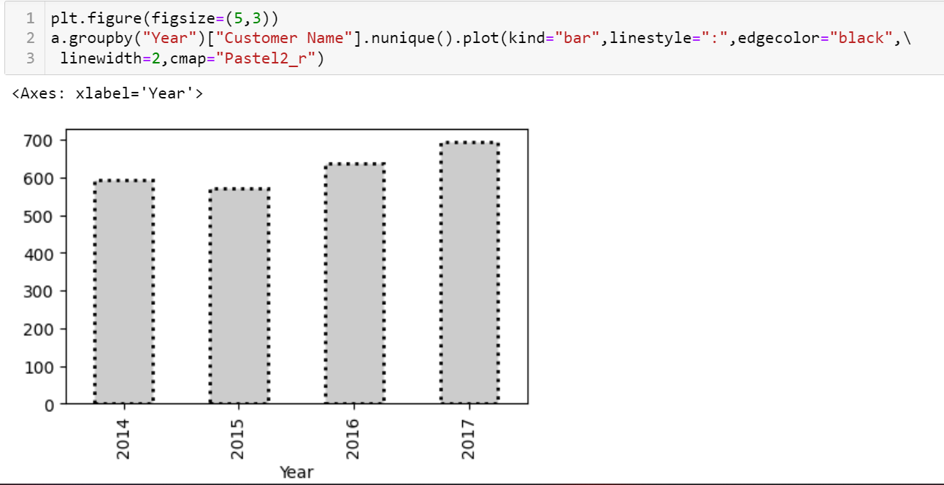
NO OF UNIQUE CUSTOMERS PER YEAR

